Slide 1
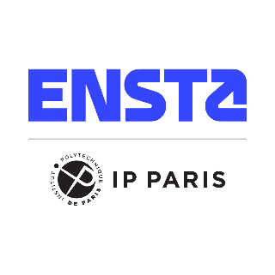
Autonomous waste picker by Franka FR3 & ROS
Authors : Dmytro SHLIAHA & Anna Sobchuk
Notes:
The future of clean streets, this robot picks up a metal can and places it in a box behind itself, fully autonomously. Over the next ten minutes we'll walk you through how it sees, localises, and grasps the can, and what we had to solve to make all work

Slide 2
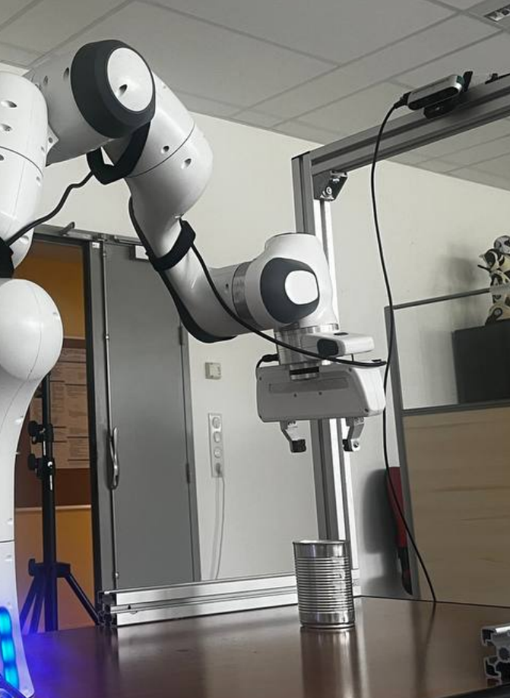
Motivation & Objectives
Pick up a metal can from anywhere on the table, no hints, no markers. The bigger picture is a robot that collects litter on its own. The hard part isn't any single algorithm, it's making four subsystems work together reliably.
Notes:
The task sounds simple but involves four tightly coupled subsystems: perception, coordinate mapping, motion planning, and actuation. All four must work correctly for the end-to-end task to succeed. The longer-term vision is autonomous litter collection. Cans are a good first target, and also a harder one than they look, because metallic surfaces break both RGB detectors and depth sensors in ways that drove several of our design choices.

Slide 3
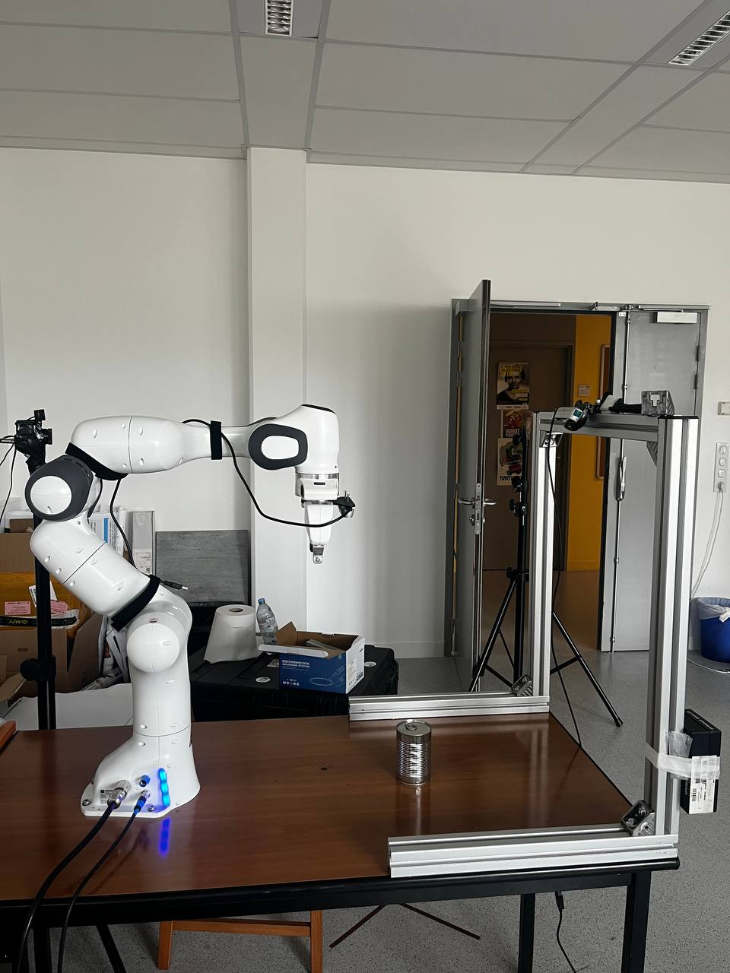
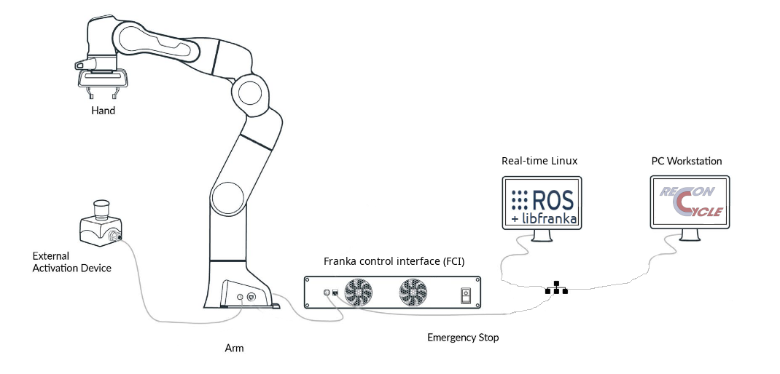
Hardware & Software Stack
Franka FR3 has 7 joints, torque sensors, and a 1 kHz control loop.
Everything runs in Docker with ROS Noetic, FrankaPy, and YOLO on a standard Ubuntu 22.04 host.
Notes:
Robot has seven joints, integrated torque sensors, 1 kHz real-time control over Ethernet. The camera is an Intel RealSense D435, mounted on a fixed aluminium frame above the table for a stable top-down view. Everything runs inside Docker because the host is Ubuntu 22.04 with ROS 2, but the robot stack needs ROS Noetic. Docker also lets us real-time scheduling privileges to libfranka without giving the container unrestricted host access.

Slide 4
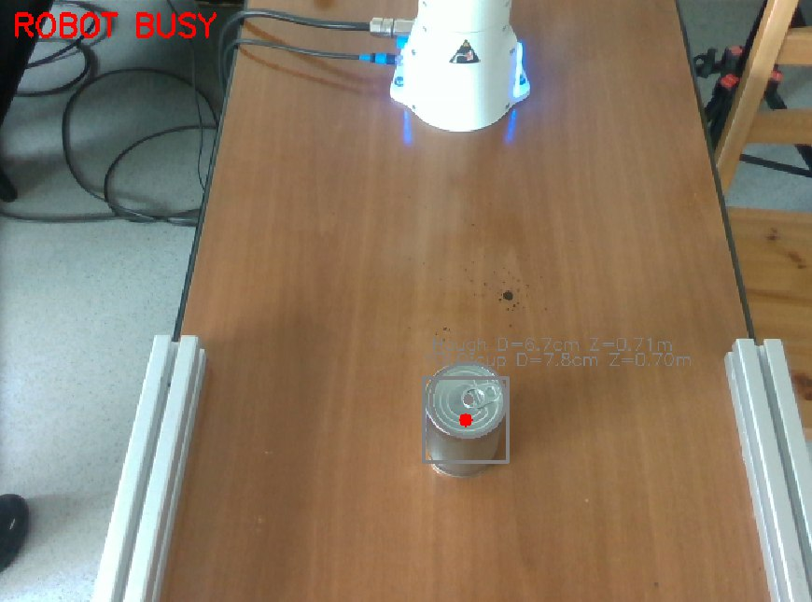
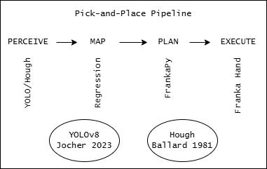
Dual Detection Pipeline
YOLOv8n conf=0.10 + geometric diameter filter (5–13 cm)
HoughCircles with CLAHE preprocessing fallback & dominant in practice
Notes:
We run two detectors in parallel on every frame. YOLO fires on the four closest COCO proxy classes at confidence 0.10 very low - then we gate on projected metric diameter between 5 and 13 centimetres. That filter rejects the robot base, frame rails, and background objects because none of them present a circular cross-section at that size and depth. When YOLO finds nothing, HoughCircles takes over. We apply CLAHE first - local contrast enhancement to recover the circular edge even when the centre of the can is blown out by specular highlight. We only publish after 8 stable frames in a row.

Slide 5
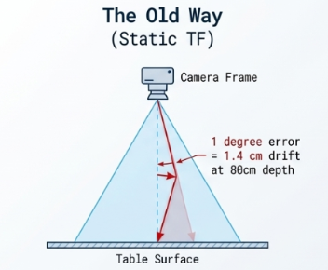
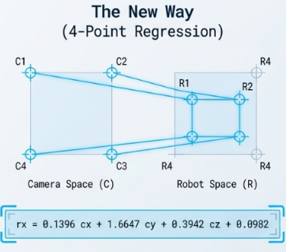
Coordinate Calibration
Workspace check: 0.25 < R_{x} < 0.80 m · |R_{y}| < 0.40 m
Notes:
The detector produces 3D camera-frame coordinates. The robot needs its own base-frame coordinates. First we tried a geometric TF transform with a measured rotation and translation. The problem: one degree of angular error at 80 centimetres becomes 1.4 centimetres of miss at the table. We replaced it with direct linear regression: place the can at 4 positions, record camera versus gripper coordinates at each, fit a linear model. The result is six scalar constants hardcoded in the script - no running node, no TF tree. Before any move we also check that the computed position is within the physically reachable workspace.

Slide 6
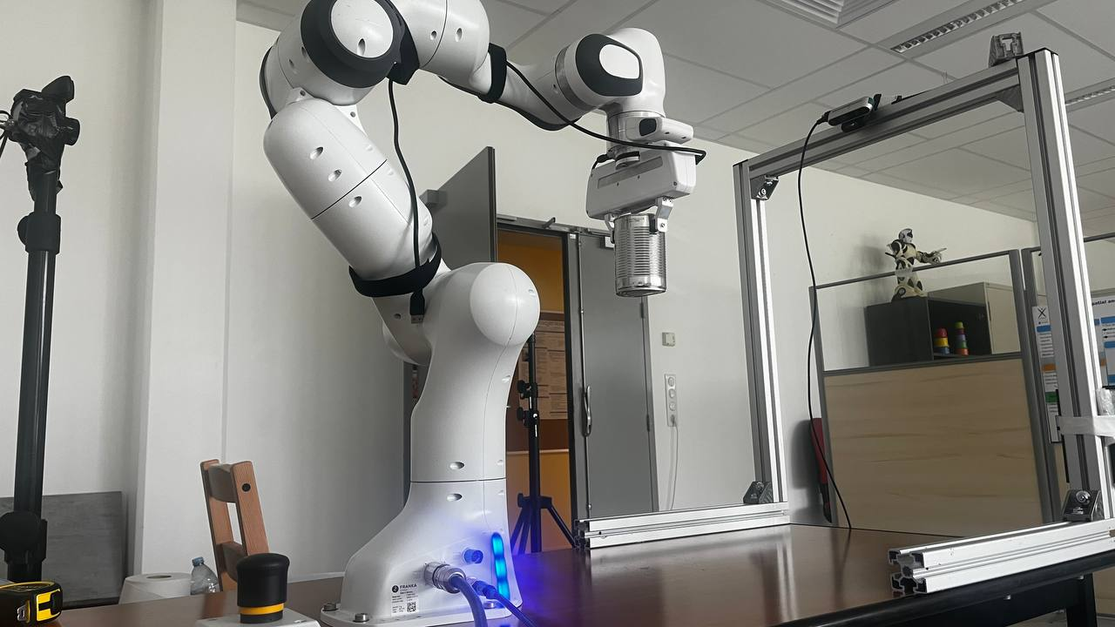
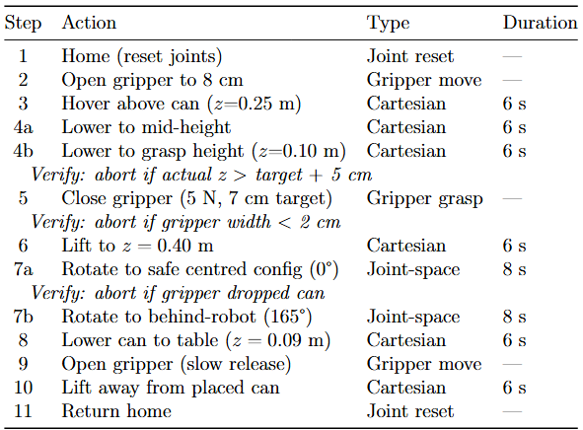
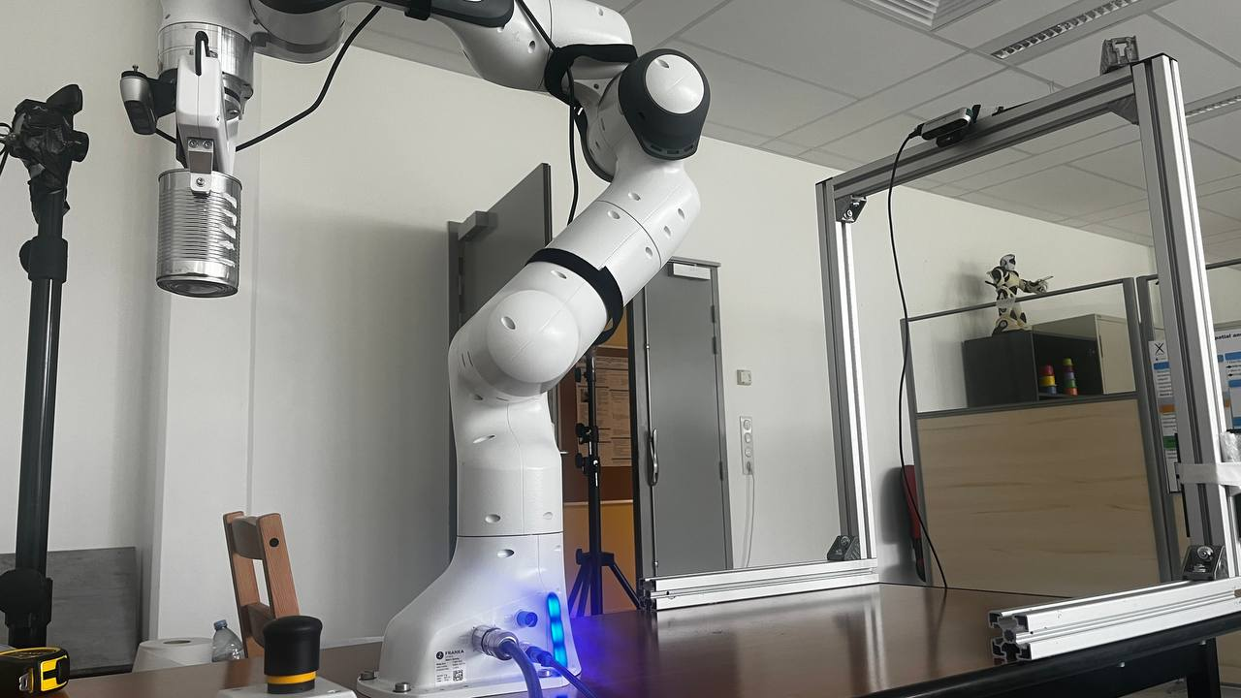
Robot Motion Control & Rotation
Notes:
The full sequence has eleven steps. The descent is split in two because a large single downward move is sometimes silently rejected by the franka-interface. The rotation was our biggest mechanical challenge. A direct 165-degree rotation from the pick position hits a near-singular configuration - in one test the arm hit the table edge. The fix: rotate first to a safe centred configuration with joint one at zero degrees, which is always reachable from any pick position, then continue to 165 degrees.

Slide 7
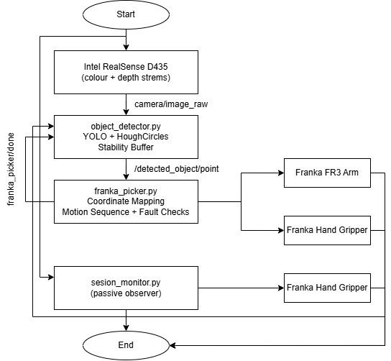

System Integration & ROS Node Architecture
Two nodes, one topic, no blocking calls. Finally block guarantees re-arm on any exit path.
Check position before moving, check descent, check jaw width after grasp. Any failure goes home and tries again.
Notes:
The two nodes never call each other directly. We chose topics over services because a service call back to the detector would block the picker if the detector crashes. All we need to communicate is a single boolean, so two topics with queue size 1 handle the entire handshake. The detector disarms itself the moment it publishes a detection and re-arms only when the picker sends done.

Slide 8
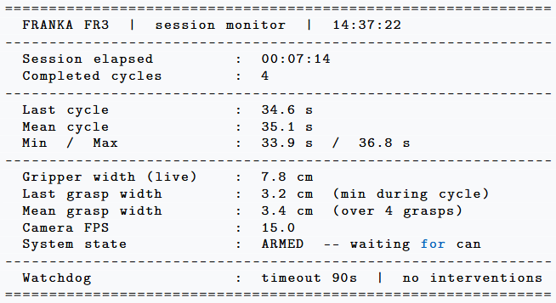
Session Monitor: Passive Telemetry & Watchdog
Read-only, zero impact on the pipeline. Found a silent failure invisible to ROS tools and recovered it automatically.
Notes:
The two application nodes give no runtime visibility into what is happening. It uses read-only subscriptions on four pre-existing topics and writes only to a new namespace that nobody else reads. The grasp quality metric is the most useful output the minimum jaw width during each cycle equals the contact width at first grasp. A mean of 3.4 centimetres on a 7.5 cm can indicates good contact. If that drifts toward 1 to 2 centimetres across sessions, recalibration is needed. The watchdog found a real failure during development: the finally block did not execute on two occasions, leaving the detector permanently stuck with no errors and all nodes alive. Completely invisible to standard ROS tools.

Slide 9
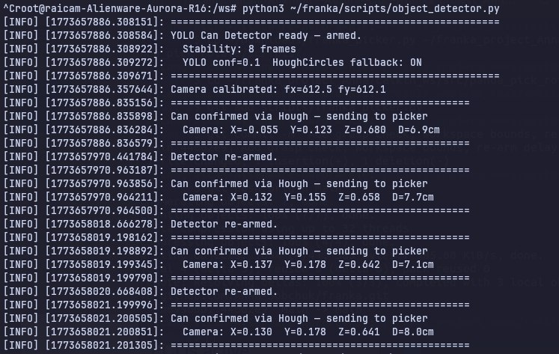
Results: 4 Consecutive Autonomous Cycles
4/4 cycles successful No human intervention between runs
Cycle time: 35 ± 2 s Motion contributes ~30–33 s
Notes:
Four consecutive cycles, each from a different can position, no intervention between runs. Cycle time is consistent at 35 seconds with under 3 seconds spread that consistency is itself evidence of reliable trajectory execution. All four cycles produced jaw separation above 2 centimetres, confirming physical contact every time. Near the calibration region centre, separation was 3 to 5 centimetres - well-centred contact.

Slide 10
Conclusion
Complete end-to-end autonomous pipeline
2-node topic architecture + passive session_monitor
github.com/Anna-Sobchuk/franka
Notes:
A fully autonomous pick-and-place pipeline: two nodes, one topic, six regression constants, and a passive monitor. The code is open source at the address on screen. Happy to take questions.

Slide 11
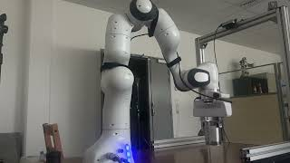

Slide 12
Thank you for your attention!

